Slide 1
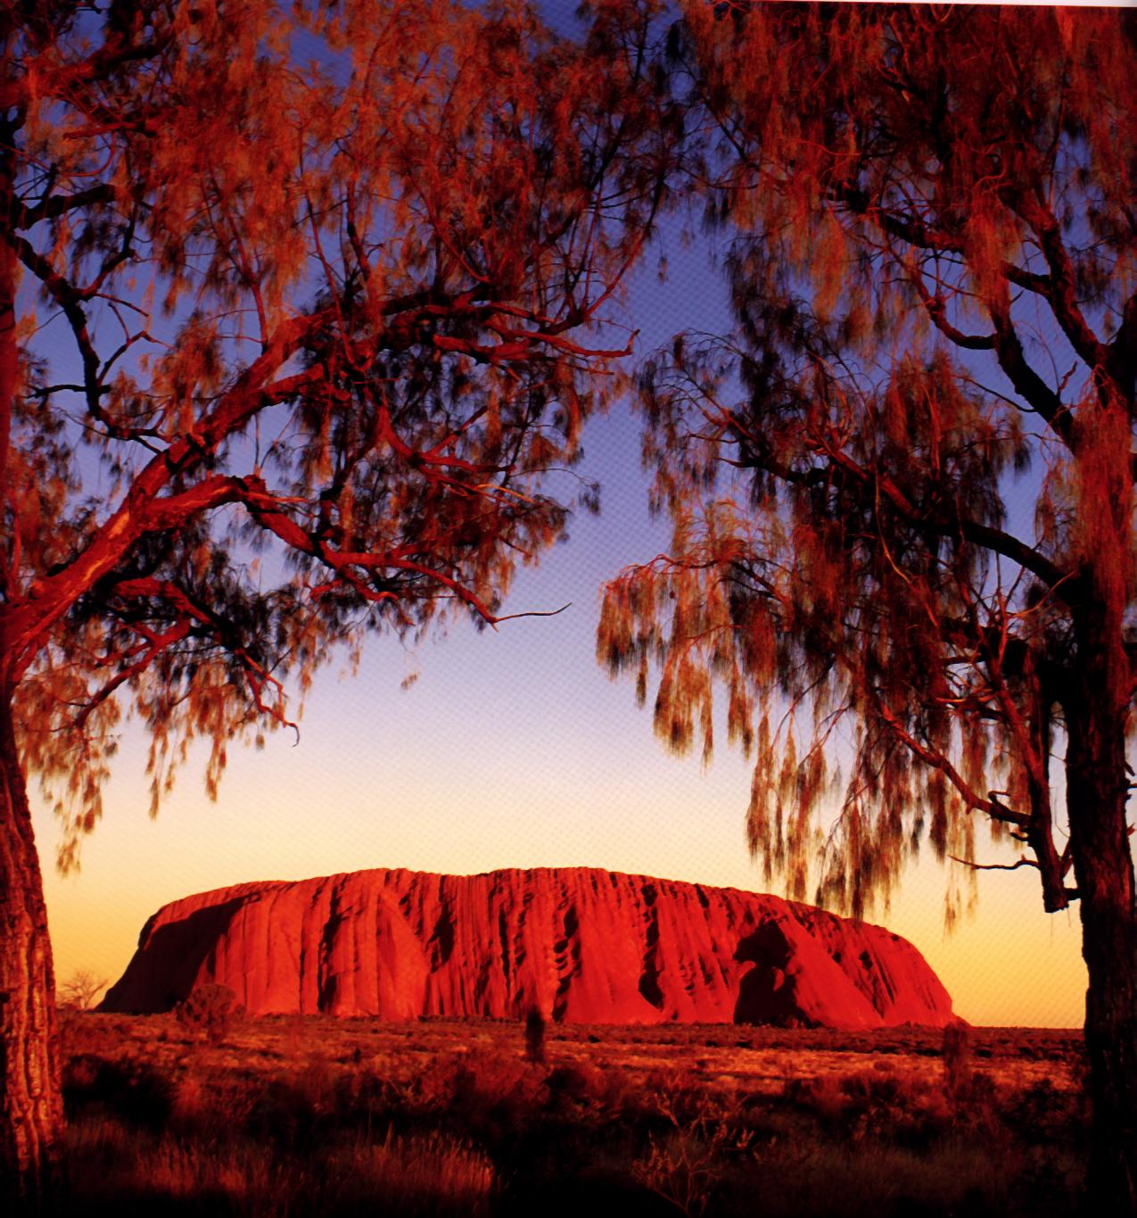
Aboriginal Art Form

Slide 2
Brief History
Australian Aboriginal art is the oldest living art tradition in the world, with paintings in rock shelters dating back 20,000 years.
The art includes naturalistic paintings of human, plant and animal figures, as well as non-naturalistic, or "abstract" designs with concentric circles, "u" shapes, and lines.
Much of Aboriginal art relates to stories of the Dreamtime. This Dreamtime is the Creation Period in Aboriginal belief, when important Ancestral Beings formed the land and created the people, plants and animals. These Ancestral Beings, often depicted in the art, may take human, animal, plant or combined forms, and taught the people their laws and ceremonies.

Slide 3
Inspiration of Aboriginal Art
Aboriginal art really involves story telling, myths, rituals, sorcery, and magic, where the artist describes their Dreaming, the stories of creation, their beliefs, and their spirituality.
The strong relationship between the ancestral beings of the 'time before time', the Dreamtime, with the landscape and every living creature they created forms the basis for this art. The ancestral spirits came to a land devoid of features and created everything -- the rivers, hills, plants, animals, people, and the relationships between people and animals.
When finished, they changed into landforms, animals, stars, or other objects. To the Aboriginal people, the past is still alive and will remain so into the future.

Slide 4
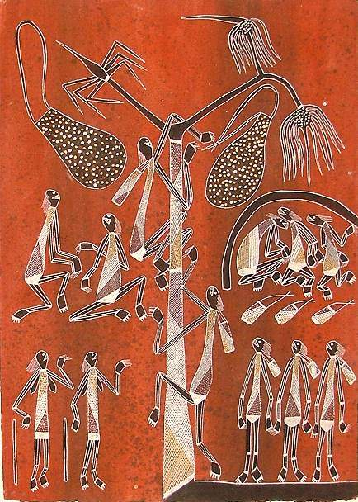
Art, Land and the Dreaming
Art is a central part of the life of Australian aborigines and takes many forms.
Traditionally it was made for purely cultural reasons and was only able to be created or viewed
by people initiated to the proper level of knowledge.
Uluru is a landscape of profound spiritual significance for Anangu Aborigines.
An non-copy art form: contrary to western culture aboriginal art must never be copied (never still-life)!

Slide 5
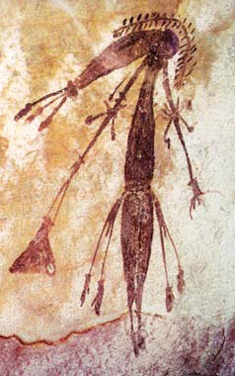
Cave Art
Bradshaw Painting, Kimberley, WA (AUS)Description: Bradshaw paintings were first discovered by Joseph Bradshaw in 1891. Many consider that the Bradshaw paintings are the earliest rock art in the Kimberley.

Slide 6
Terminology
Dreamtime
The creation of time. This symbolises that all life to the Aboriginal people is part of on interconnected system
Creative Ancestors
They commenced their work of creation, not only making all things but naming them. The creative ancestors are responsible for everything there is, including the laws, customs and languages.
The Rainbow Serpent
A creative ancestor (mother of Life). A giant serpent (snake) who had been sleeping under the ground pushed upward and writhed across the void, creating as she went along the landscape in which we live today.
Uluru
This is the Aboriginal name for Ayers Rock. This is a giant sandstone monolith rising nearly 400 metres above the surrounding desert. It is perhaps the most sacred place for Aboriginal people right across Australia, for here many ancestral and Dreaming tracks came together.
Notes:
Australia
Important Termnology
Dreamtime
The creation of time. This symbolises that all life to the Aboriginal people is part of on interconnected system, one vast network of relationships which came into existence with the stirring of the great archetypes, the spirit ancestors who emerged during the Dreamtime.
Creative Ancestors
These came in many shapes and forms and found themselves in the void, the featureless landscape, the waveless ocean. They had descended from the sky or came from the sea and when they reached the land they commenced their work of creation, not only making all things but naming them. The creative ancestors are responsible for evertyhing there is, including the laws, customs and languages.
The Rainbow Serpent
A creative ancestor (mother of Life). A giant serpent (snake) who had been sleeping under the ground pushed upward and writhed across the void, creating as she went along the landscape in which we live today.
Uluru
This is the Aboriginal name for Ayers Rock. This is a giant sandstone monolith rising nearly 400 metres above the surrounding desert. It is perhaps the most sacred place for Aboriginal people right across Australia, for here many ancestral and Dreaming tracks came together.
Totems
These are a way of ordering the universe and the species therein. In the Dreamtime human beings were one with their Dreaming. They were at once Fish, Emus, Kangaroos, Waterlillies etc. After being given human form the animal etc, then became their Totem or Dreaming.

Slide 7

Today’s learning objective
To select one symbol from worksheet created last week &
Create a mini painting using the same style as Aboriginals
Used to create their dreamings!!
REMEMBER DOTS &LINES!!

Slide 8

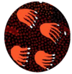



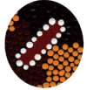
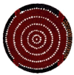

Fire sticks

Slide 9
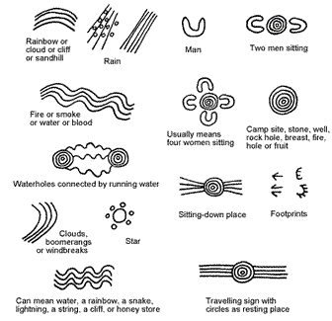

Slide 10
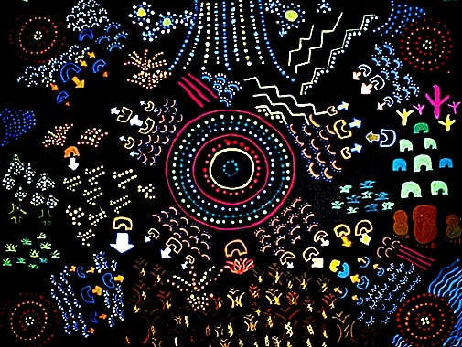

Slide 11
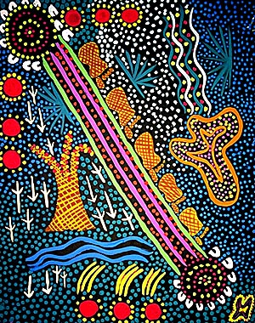

Slide 12
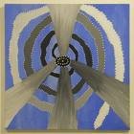
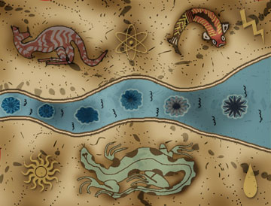

Slide 13
